Slide 1

an
Enhanced Integrated Care Services
^{Kate Pym /Debbie Stuart}
Strategy Development Manager/Clinical Lead
MITIE Healthcare Solutions/Bladder & Bowel Foundation

Slide 2
Agenda
What is MITIE Healthcare Solutions
What is B&BF
Benefits of partnership
Standard Social Care Services
Enhanced Services and integrated care
What’s in it for commercial partners
Summary

Slide 3
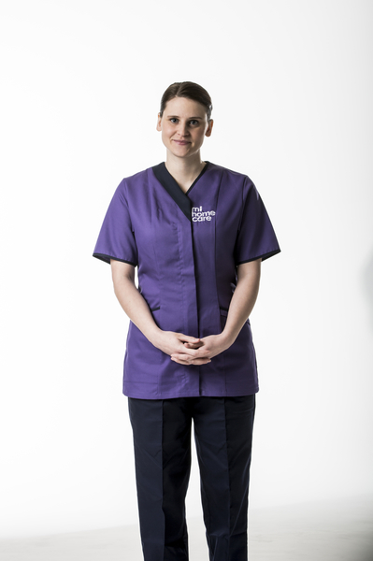
MITIE – Who are we?
Strategic outsourcing business
Historically focus on facilities management & energy services
£2 billion revenues
FTSE 250 company
Values
  People
  Passion
  Fresh thinking
  Exciting futures

Slide 4





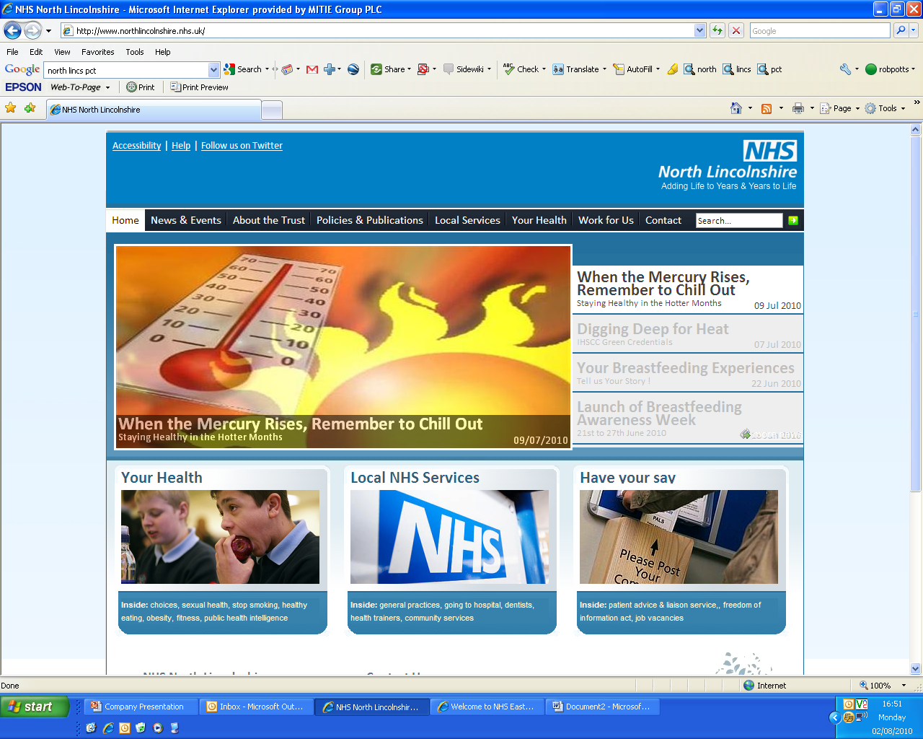




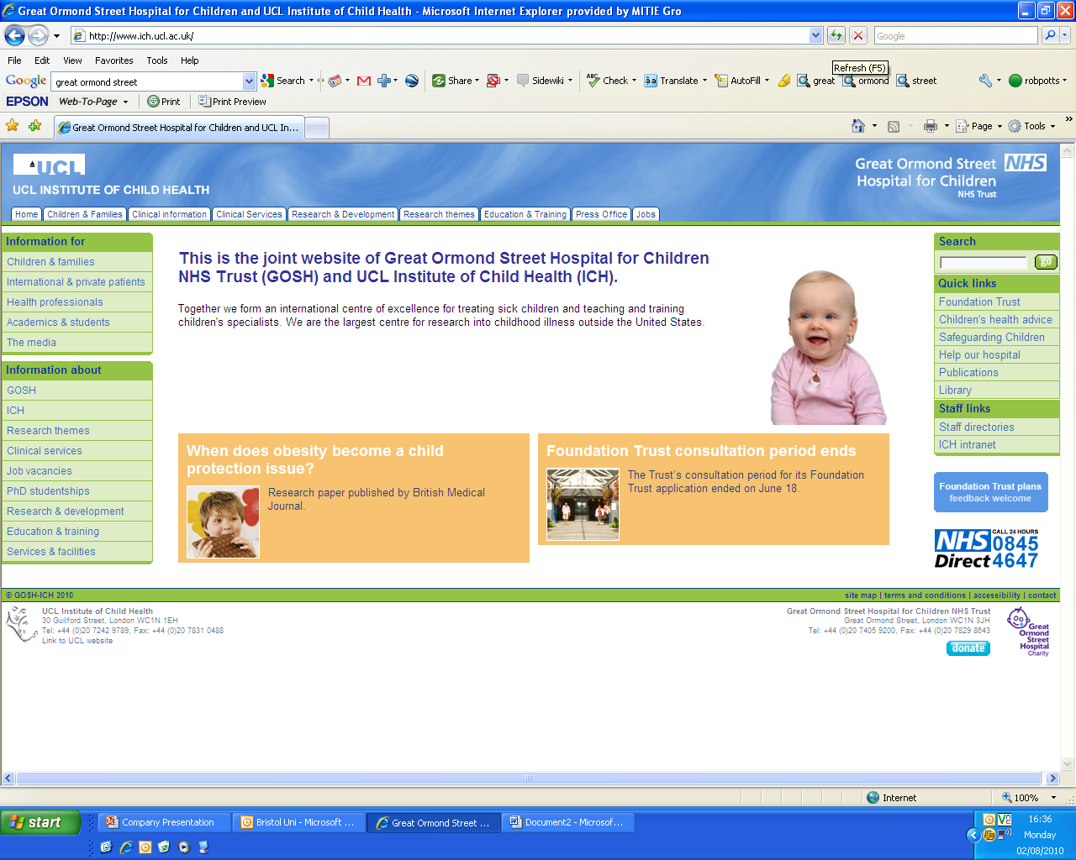


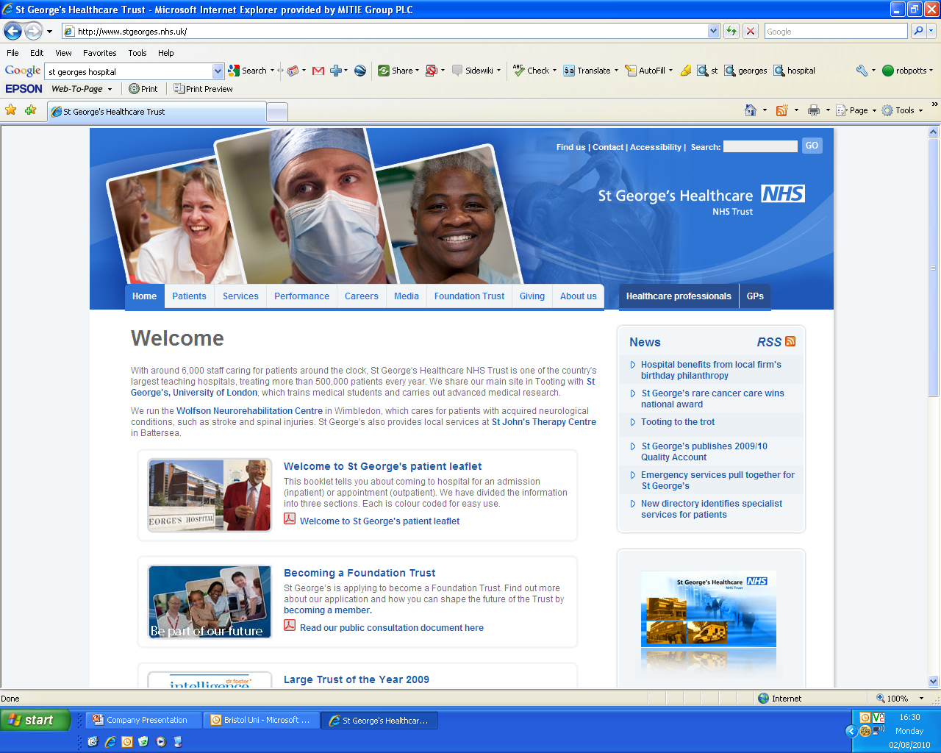
MITIE experience in health

Slide 5
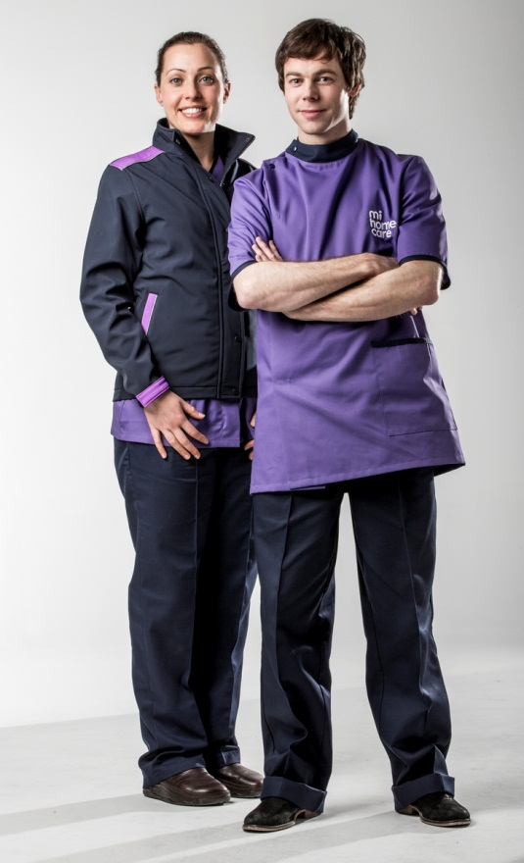
MITIE in Homecare
Oct 2012 MITIE acquire Enara Group
4th largest homecare provider UK
Platform for integrated care business
125,000 HOURS/WEEK
6,000
CARERS
15M
VISITS PER ANNUM

Slide 6

Who Are We – Bladder & Bowel Foundation
UK Wide charitable organisation supporting people with bladder and bowel problems
Partners with experts working in the field of continence care
Aim is to inspire change and create opportunities enabling people with bladder and bowel control problems to have a voice and equal choice
Dedicated clinical helpline
Clinical Skills / Training Provider

Slide 7

Benefits of Partnership
Provide enhanced community care packages incorporating gold standard continence management
Managing patients in their own homes for longer enhancing quality of life .
Working seamlessly with local providers.
Ensuring hard to reach patients get access to the most up to date treatments
Developing a new specialist nurse service in the community “the B&BF Nurse”
Enhanced access to carers/ service users through quarterly Carer Support Days

Slide 8
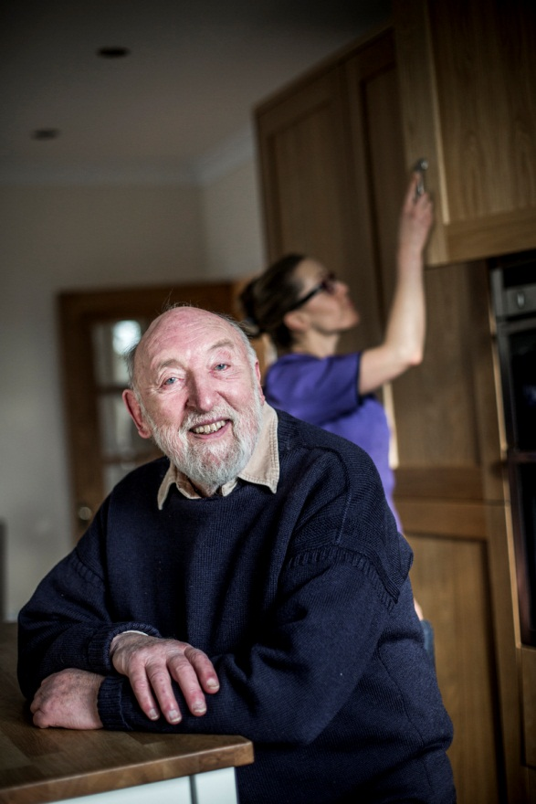
Standard Social Care Support Services
Going to Bed Service
Respite Care
Continence Care
Personal Care
Getting up Service
Medication Support
Domestic Support
Shopping
Companionship
General housework
Night & Day Sitting Service
Meal Preparation
Laundry & Ironing

Slide 9
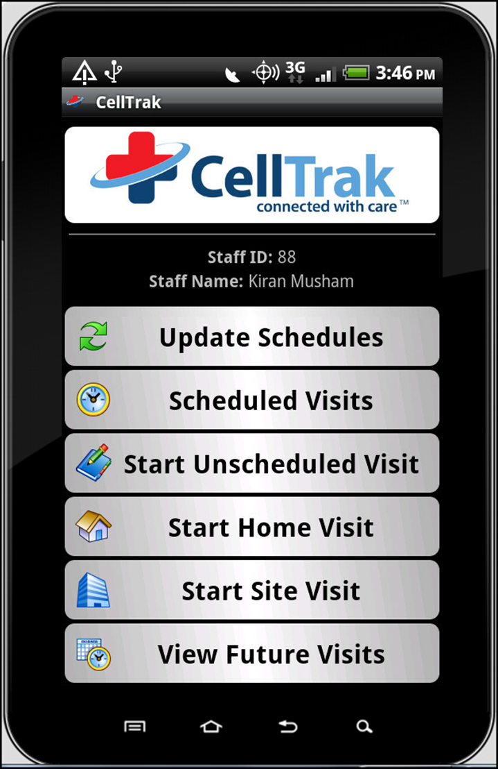

MITIE in Homecare
Mobile technology – for all care staff enabling efficient inventory management and data collection.

Slide 10
Integrated Care - Benefits to the Health Economy
Maximising unlimited capacity in peoples homes compared to compromised capacity in acute care
Lower cost of care provision in community
Reduced impact on NHS Staff time
Reduced admissions / Readmissions
Potential reduced length of stay due to reduced risk of hospital acquired infection
Improved patient choice for those with protected characteristics
Consistency of data collection for health monitoring
Reduced inconvenience and intrusion for patients
Improved patient dignity and privacy
Better patient experience

Slide 11
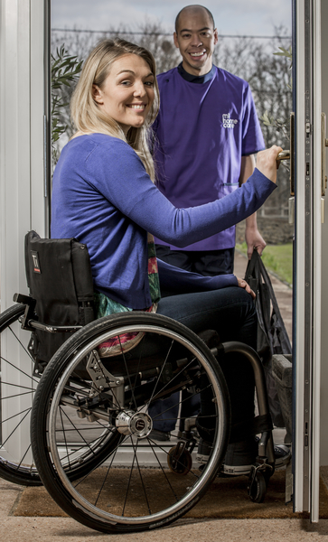
Enhanced Services
MS
Acquired Spinal Injury
Stroke
Nursing
Live-In Care
End of Life
Mental Health
Waking Night- Admission Avoidance
Rapid Response
Bereavement
Dementia
Reablement
Acquired Brain Injury
Diabetes
Complex Care
Bariatric Care
Specialist Continence
Learning Disabilities
Autism

Slide 12

B&BF Continence Nurse
Sponsored by B&BF Corporate partners
Responsive assessment treatment and if necessary onward referral
Potential for Nurse prescriber
Lead for promotion of best practice for continence care in community
Support and mentor for care workers – developing continence care champions
Potential for research / data collection

Slide 13
Potential Value Commercial Partners / Sponsors
Sandwell population currently 309,000 due to increase by 5% by 2025
49,250 of current population over 65 yrs
B&BF figures (2009) suggest 11% over 65 yrs report some form of bowel control problem
Indicating that 5,418 of those over 65 yrs in local community have bowel control problems
APPG (2011) figures indicate 31% of over 65 yrs suffer bladder instability
Indicating that 15,267 of the over 65’s in the local authority have bladder instability

Slide 14
Future Opportunities
Oxfordshire County Council agreed to pilot
Potential to offer to all new domiciliary care bids
Opportunity to expand into existing care contracts
Growing links with primary care, secondary care and third sector organisations working with the elderly and hard to reach patients
Inventory management can be included using telehealth data collection
Data collection for studies
Patient education and information
Potential for Nurse Prescriber

Slide 15
Summary
Community Care Workers working with a qualified specialist accessing hard to reach patients
Reactive, responsive services
Rapid referral into community continence services
Care Workers have strong and trusted relationships with clients and their families
Improving the abilities of patients and carers to self-manage
24 hour clinical helpline back-up
Dissemination of clinical and product patient information directly to service users / carers

